Slide 1


QUIZ GAME USING C
Subject: Foundations of Programming
Ashwin Gupta - 1262253478
Rishab Oswal - 1262253561
Harsh Phule - 1262250816
Saransh Parihar - 1262253066

Slide 2

Project Overview
The Quiz Game using C is a console-based program designed to test basic knowledge of C programming.
The program displays a set of simple questions related to C language concepts such as data types, operators, and control statements.
The user selects answers, and the program checks correctness and calculates the final score.
This project demonstrates the use of input/output functions, conditional statements, and basic logic in C.

Slide 3

Program Objectives
To develop a simple quiz game using C programming language
To understand and apply conditional statements (if-else)
To practice input and output operations in C
To calculate and display the user’s score based on correct answers
To strengthen basic programming logic and problem-solving skills

Slide 4

Algorithm
Step 1 : Start
Step 2 : Declare required variables including int score = 0
Step 3 : Print the question and options(if any)
Step 4 : Take input (answer) from user
Step 5 : If input==correct answer Score + 1 Otherwise Score remains same
Step 6 : Go to step 3 until all the questions are displayed
Step 7 : Print final score
Step 8 : Stop

Slide 5

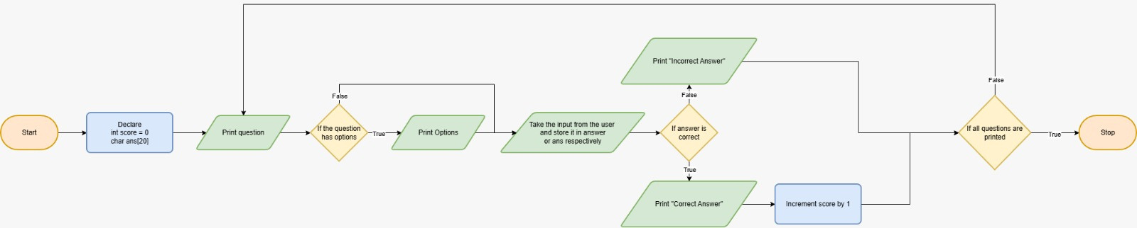
Flowchart

Slide 6
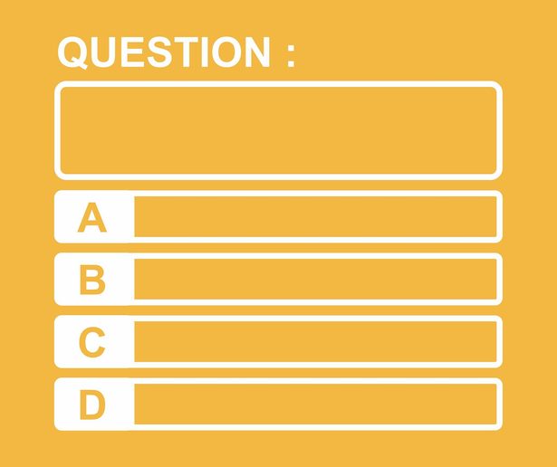
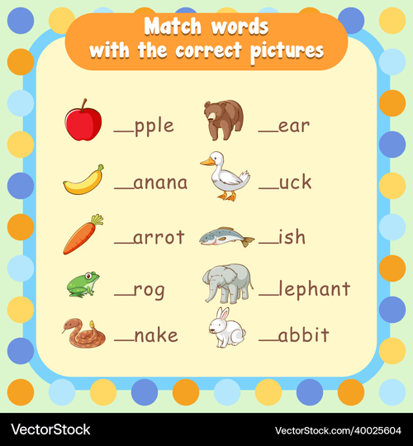

Program Features
Multiple Choice
Fill in the Blanks
True/False
The program includes basic multiple-choice questions related to C programming concepts.
Simple fill-in-the-blank questions are used to test understanding of C syntax and definitions.
True or false questions are included to quickly assess basic conceptual knowledge.

Slide 7
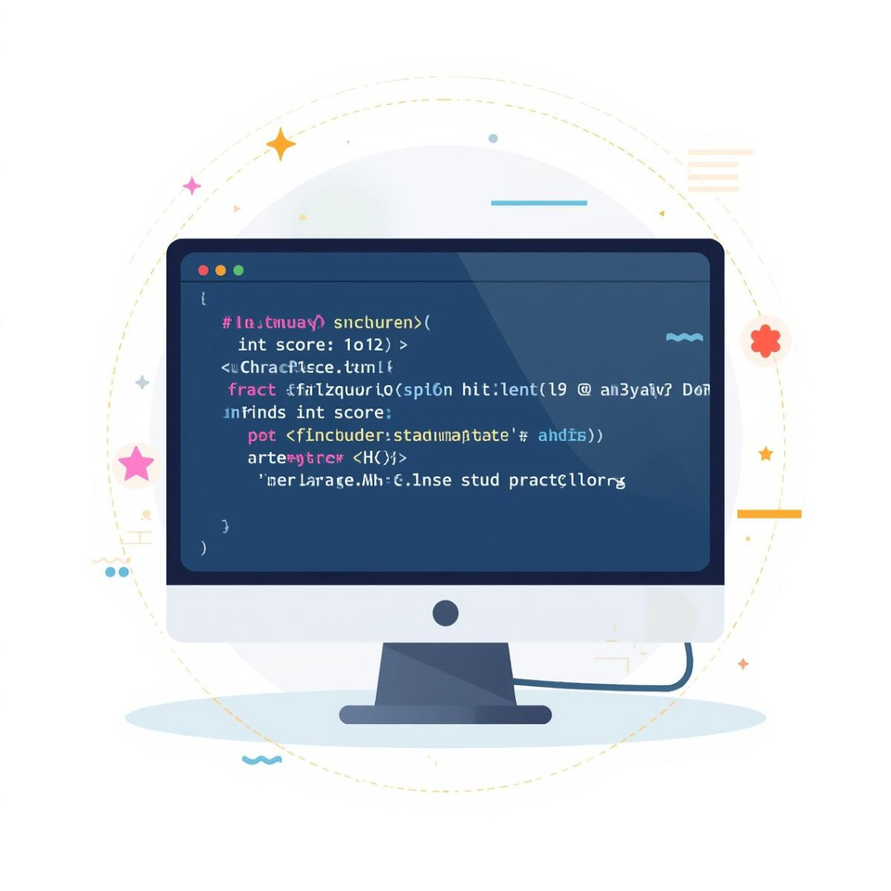
Code Structure
The program is written using basic C language constructs.
The stdio.h header file is used for input and output operations.
The program starts execution from the main() function.
Variables are used to store user answers and the quiz score.
Conditional statements are used to check answers and update the score.

Slide 8
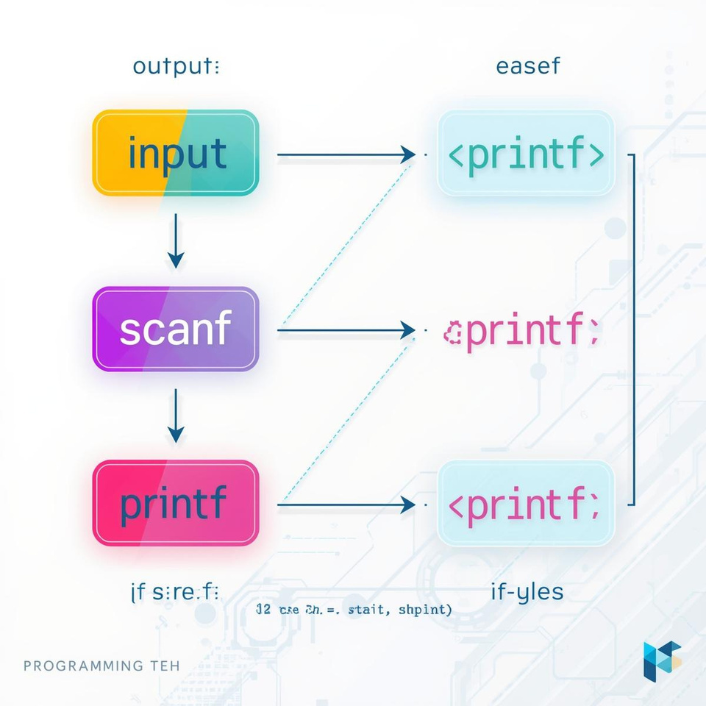
Logic in Action
The quiz program uses printf() to display questions and scanf() to accept user input.
Conditional statements (if-else) are used to compare user answers with correct answers.
When the answer is correct, the score is incremented.
This logic continues until all questions are answered.

Slide 9

Output Demonstration of Quiz Interaction
This slide shows the output of the quiz program executed in the console.
The user answers the displayed questions, and the program evaluates responses in real time.
After completing the quiz, the final score is displayed to the user.

Slide 10

1
Simple Interface
Easy-to-use console interface suitable for beginners.
Strengths of the Program
Concept Clarity
2
Covers basic C programming concepts such as input, output, and conditional logic.
3
Beginner Friendly
Designed for students learning C programming fundamentals.

Slide 11
Input Validation
Input validation can be added to handle invalid user responses.
Possible Improvements
User Interface
Better formatting can improve readability of questions and options.
Code Optimization
Loops and functions can be used to reduce code repetition and improve efficiency.

Slide 12

Conclusion
In conclusion, the Quiz Game using C programming was successfully implemented.
This project helped us understand and apply basic C programming concepts such as input/output operations, conditional statements, and logical decision-making.
The quiz program evaluates user responses and calculates the final score correctly.
Overall, this project strengthened our understanding of fundamental programming concepts in C.

Slide 13

Questions and Discussion Time
Thank you for your time and attention.
We are ready to answer any questions related to our project.

